Slide 1
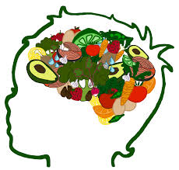
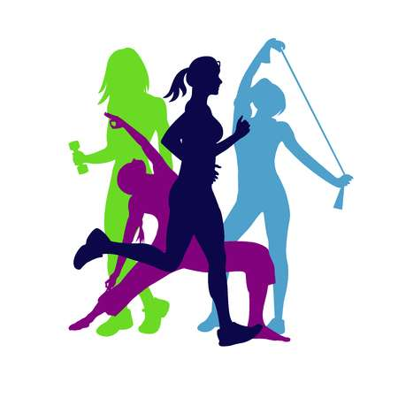
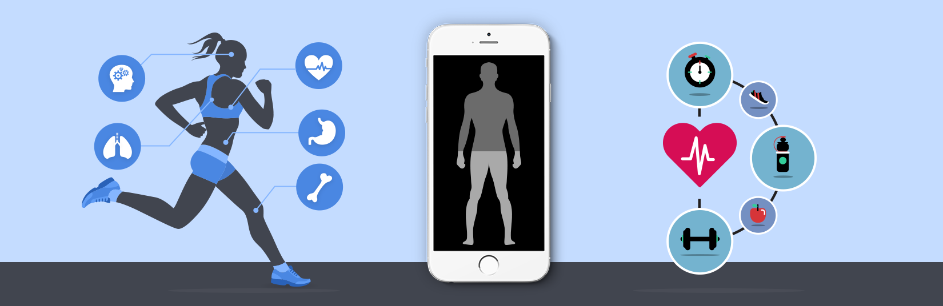
Health Applications
Fizza Zaman
Professor Flinn
COSC 631

Slide 2
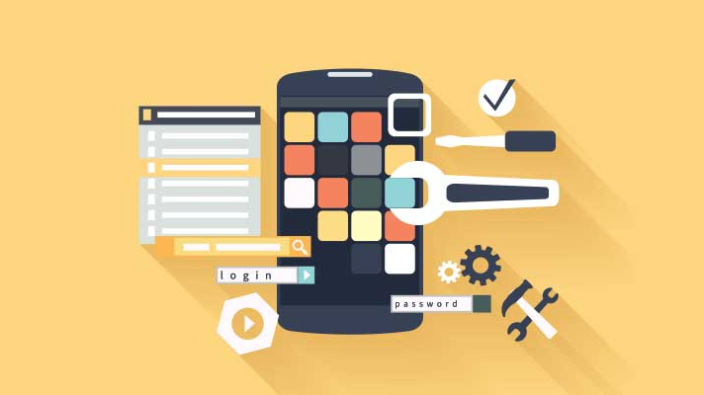
PURPOSE
Overview of health applications, their usage, and real-world examples
Why health applications are used
Interface Design
Framework of Functionalities
Analyzing the impact of web development on health application users
Social support and influence
Physical, mental, & emotional changes
Analyzing the impact of health application usage on web development
Mobile HCI
Data Collection
Future Goals of health applications
Help Elderly
Mediate Privacy Concerns

Slide 3
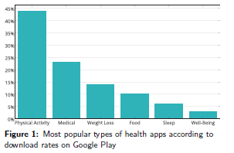
HEALTH APP USAGE
With the rise of technology and interactions in these technologies, users are more motivated to track their health digitally
[9], [18]

Slide 4
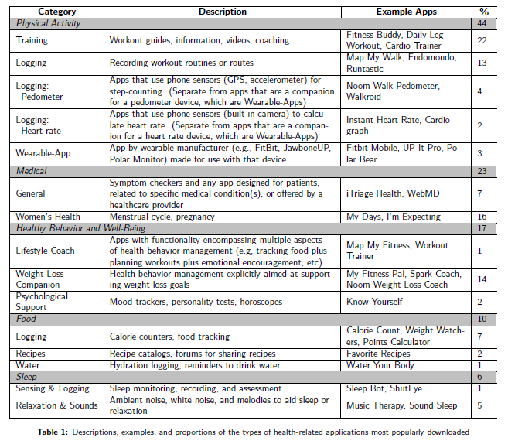
Descriptions of the types of health-related applications most popularly downloaded [18]

Slide 5
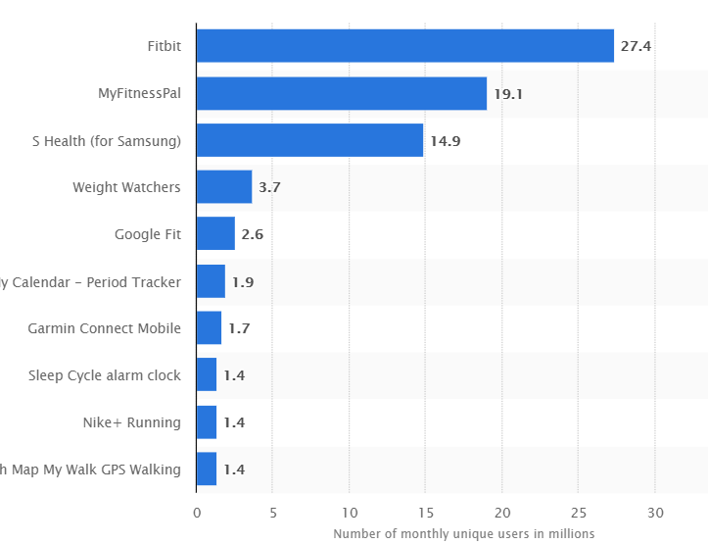
REAL-WORLD APPLICATIONS
Fitbit
MyFitnessPal
S Health
Weight Watchers
Google Fit
[11], [14]

Slide 6
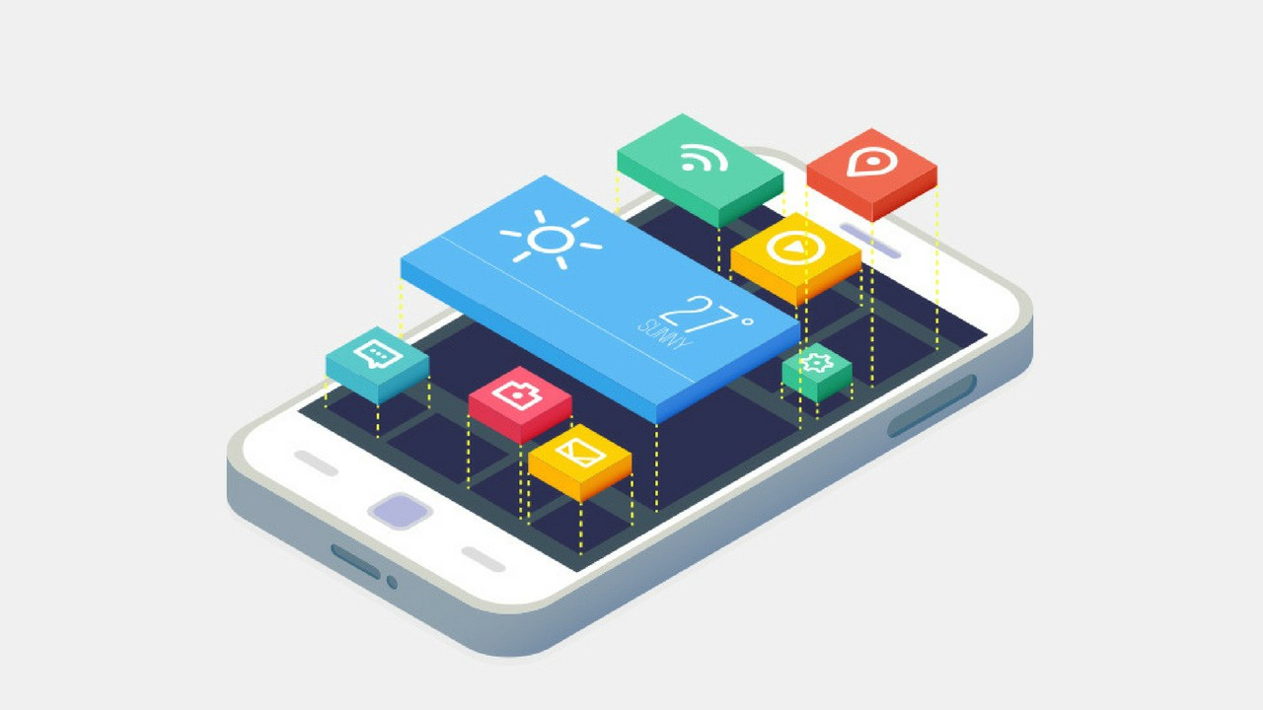
User Interface Design Principles Used in Health Applications
SHE design principle [10]
AFV Framework [12]

Slide 7
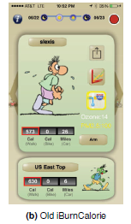
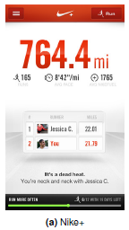
SHE
Maeda’s design principle of “SHE”
Shrink
Hide
Embody
Ex: Nike+ app
[10]

Slide 8
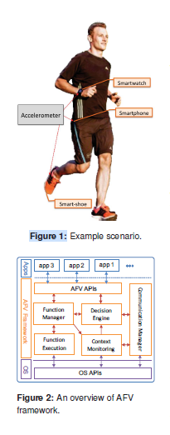
AFV Framework
Optimization
Adaption
Usability
[12]

Slide 9
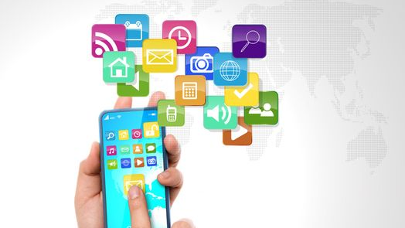
Framework of Functionalities in Health Applications
Decision Sequence
Perceived usability
[17]

Slide 10
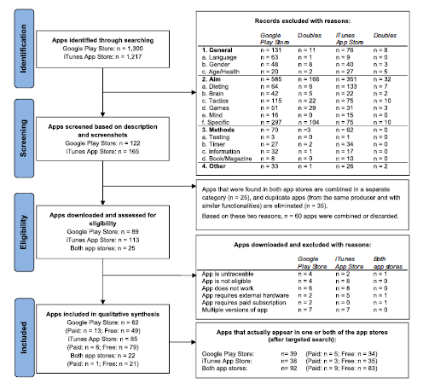
Decision Sequence
Identification
Screening
Eligibility
Included or Excluded
[17]

Slide 11
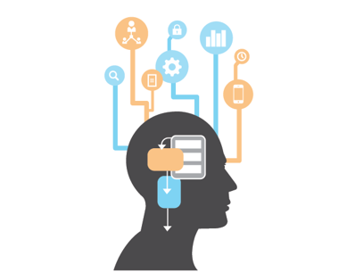
Perceived Usability
Determined by the implemented features:
Measuring & Monitoring
Information & Analysis
Support & Feedback
Adaptation
Social
Usability
[17]

Slide 12

Impact of Web Development on Health Application Users
Social support and influence [6]
Physical, mental and emotional changes [2], [16]

Slide 13
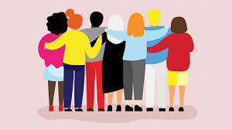
Social Support and Influence
Motivates users
Creates recognition and collaboration
Leveraged by health apps
[6]

Slide 14
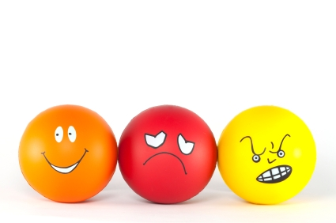
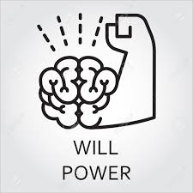

Physical, Mental, and Emotional Changes
Physical:
Role playing games (RPG) for increasing physical activity
Ex: ZombiesRun!
Emotional:
Wearables that connect to mobile apps
Create incentive
Serve as a reminder of positive affect
Direct result of mental changes
Mental:
The use of willpower
Ex: goal setting and tracking
Creates positive emotional changes
[2], [16]

Slide 15
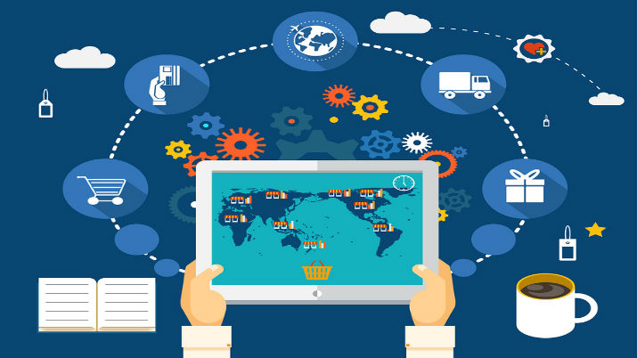
Impact of Health Application Usage on Web Development
Mobile Human-Computer Interaction (HCI)
[19], [21]
Data Collection
[3]

Slide 16
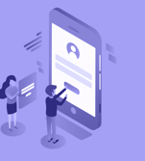
Mobile Human-Computer Interaction (HCI)
Examples:
Health applications connected to other devices or wearables
Increasing mobile HCI means:
More programmers
New user interface software
Multidisciplinary projects
User-centered systems
Usability engineering

Slide 17
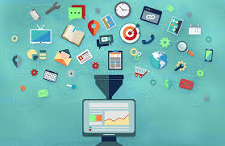
Data Collection
Facilitated by technology
Reduces burden on participants
Enables data collection outside of a lab
Improves data quality
[3]

Slide 18
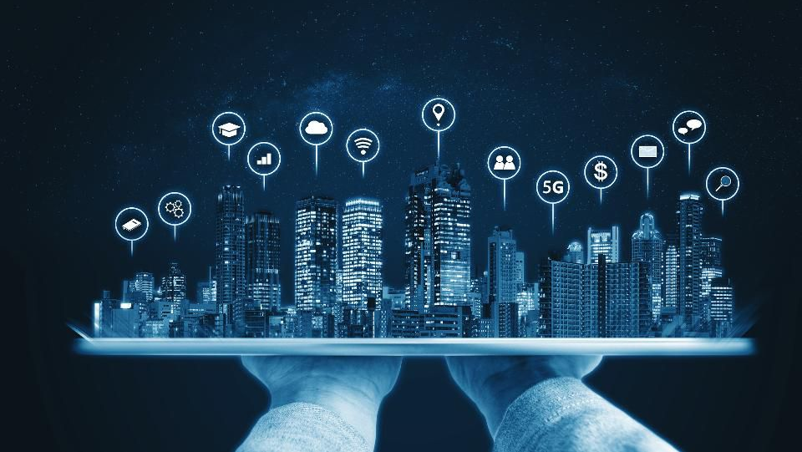
Future Goals of Health Applications
Helping the elderly [14]
Mediate privacy concerns [11], [18]

Slide 19
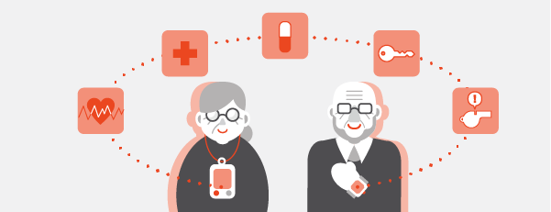
Helping the Elderly
Persuasive communication via persuasive technology
Designing a user interface for the elderly
More research and work needed
[14]

Slide 20
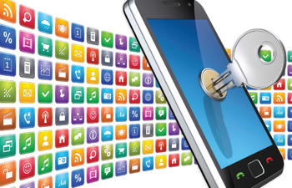
Mediate Privacy Concerns
Top reason for health application exclusion/abandonment
Created using various technology
Ex: cameras, sensors
Pushes boundaries of privacy
Various solutions, but not for “all” users
Requires tech-savvy users
[11], [18]

Slide 21
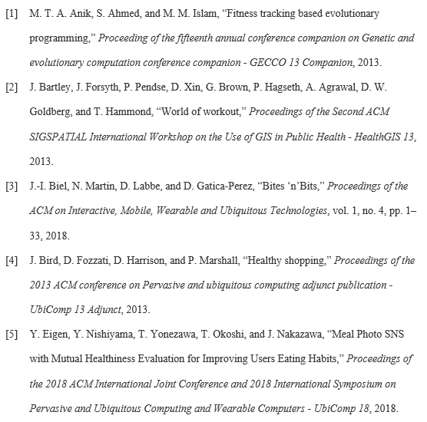
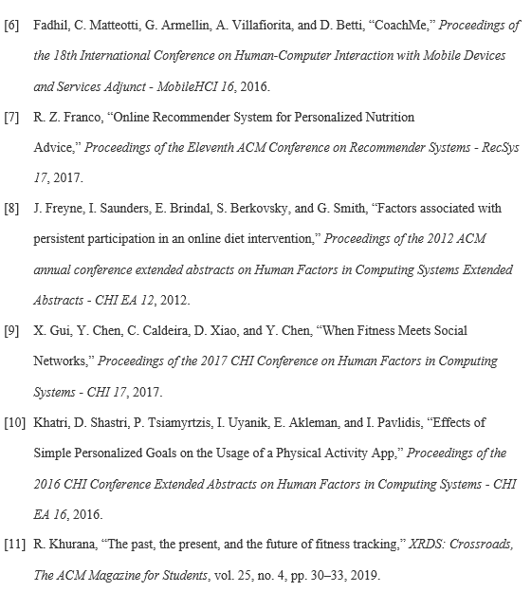
REFERENCES

Slide 22
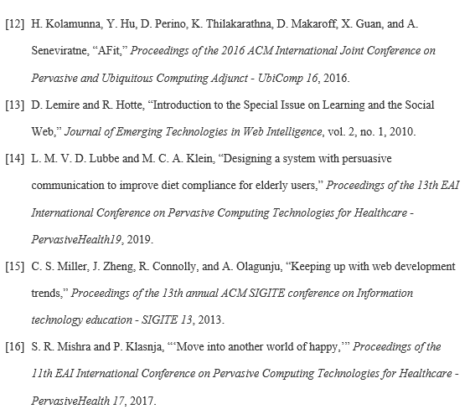
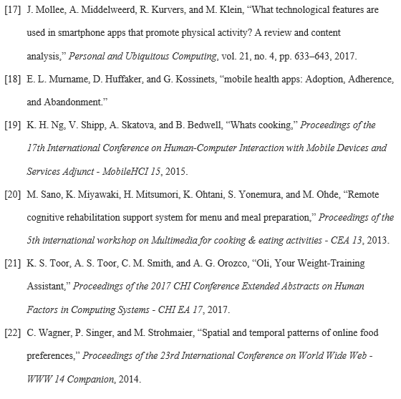
REFERENCES

